Slide 1
caCORE SDK
Satish Patel
Ekagra Software Tech.
patelsat@mail.nih.gov
1/28/2008

Slide 2
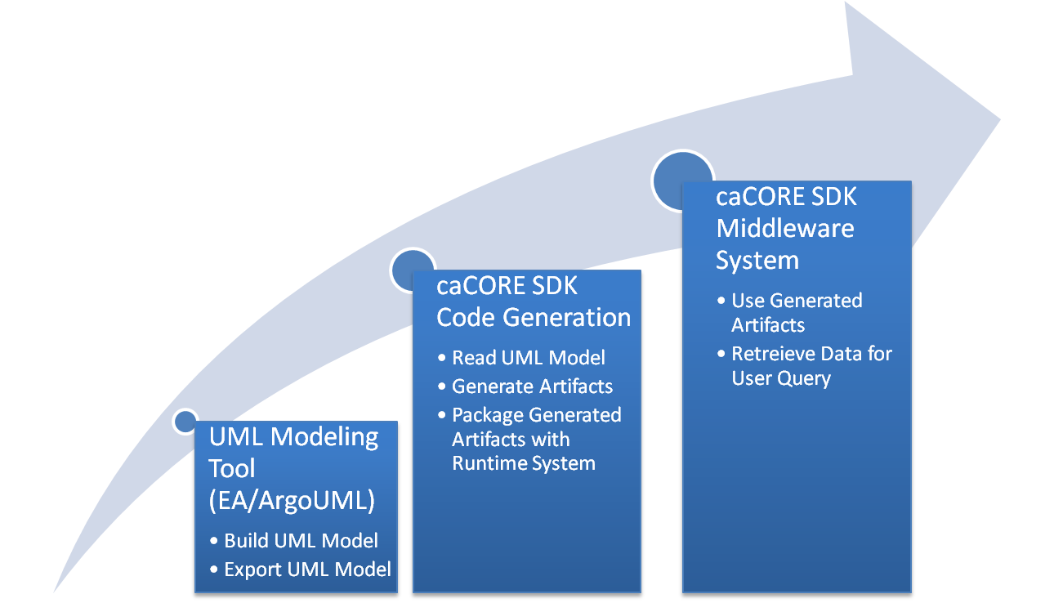
SDK System Generation Process

Slide 3






SDK Generated Silver Level System
Core Services
Registered in
Semantically described with terminology from
Object
Definition
SDK Service
SDK Client
SDK Service API
SDK Client API
Client App
Database
Reads
Objects
Objects
Client uses

Slide 4
SDK 4.0 – New Features
Re-architected system
  Runs on POJO beans unlike beans containing logic to connect to server
  AOP based framework is used to fetch associated objects from server
  Concurrently connects to different services from the same generated client
  System can be easily extended to perform additional functions
Enhanced security
  Separate Authentication/Authorization aspects
  Support for concurrent users on secured client
  First generation Object Instance and Attribute Level security with CSM
Enhanced code generation
  Users can detect code generation errors to the exact location
  Significantly reduced artifact generation

Slide 5
SDK 4.0 – New Features
Performance Improvement
  Significantly improved code generation performance
  Improved performance of generated queries
Support for UML modeling tool
  Continued support for Enterprise Architect
  Additional support for open source tool (ArgoUML)
  Support for roundtrip XMI files
Relaxed restrictions on object/data model development
  No emphasis on use of “id” attribute for object identifier
  Support primitive java data types in the object model
  Supports table per class hierarchy mode of inheritance mapping

Slide 6
SDK 4.1 – Upcoming Release
Support for HL7 complex data types
  Allows user to use HL7 data types in UML model
  Users can map the complex data types to the database by leveraging SDK’s code generation capabilities
Freestyle search
  Provide search engine like capabilities on the user’s database
  Ability to specify search index fields in UML model
Graphical installer to generate system using SDK
Support for UML and O/R mapping features
  Abstract classes
  Marker Interfaces
  Enumeration (caDSR Enumerated Value domains)

Slide 7
caGrid Data Services Integration with caCORE SDK 4.0
Support targeted for caGrid 1.2
Provided by new Data Service style implementation and query processor
Data Service styles allow extension and flexibility
  Existing styles support SDK versions 3.1 and 3.2.1
  Future SDK versions can be supported without a full release of caGrid
  Styles may be added by third party developers
Query Processors based on pluggable architecture
  Interface between CQL and backend data store
  Configurable at runtime
  caCORE SDK support provided by conversion from CQL to HQL
  Positional HQL query parameters
    New feature in caCORE SDK 4.0
  Allows queries using special characters and punctuation

Slide 8
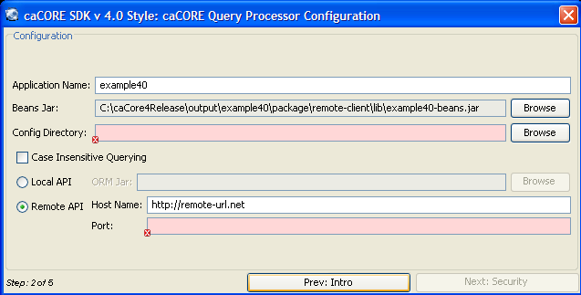
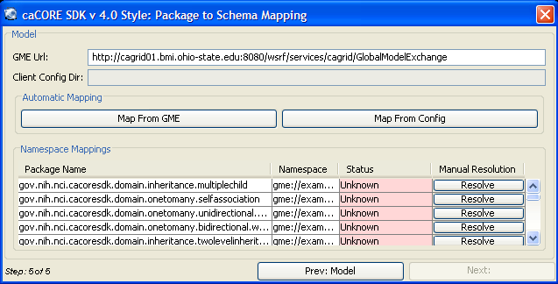
caGrid Data Services Integration with caCORE SDK 4.0
Wizard like interface with simple selection of SDK components
Validation on each panel
  Visual feedback reduces configuration errors
Simplified schema mapping
  One button to fetch schemas from the SDK’s configuration directory
Validation of mappings
  At-a-glance verification of mapping completeness

Slide 9



SDK Grid Integration
Core Services
Registered in
Registered in
Semantically described with terminology from
Object
Definition
WSDL
XSD
Service Definition
Client uses
Validate against
SDK Service
SDK Client/ Grid Service
Grid Client
SDK Service API
SDK Client API
Grid Service
Grid Client
Client App
Database
Reads
Objects
Objects
XML
Objects

Slide 10
SDK Grid Joint Development Effort
Freeze integration points
Joint effort on CQL development
  CQL to HQL translator
Java beans generation from UML model
XSD generation from GME namespace tags
XML serialization/de-serialization
Leverage ‘Introduce’ data service plugin architecture to support latest release of SDK
SDK Client/ Grid Service
SDK Client API
Grid Service
Objects

Slide 11
Questions

